Slide 1


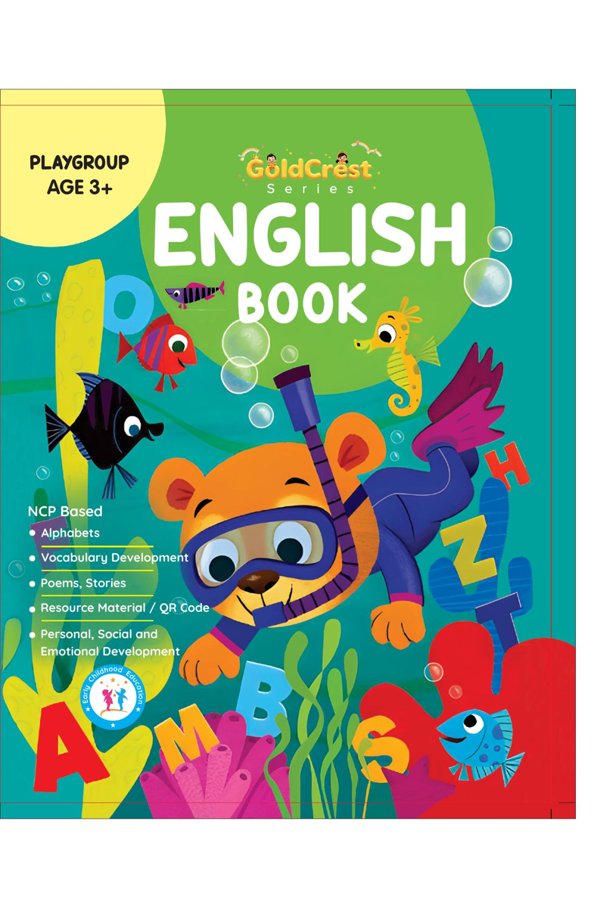
GoldCrest English Book
Playgroup • Age 3+
An activity-based early-years book from the GoldCrest Series.
A Project of Azhar Publishers & Book Factory

Slide 2
i
What's Inside
GoldCrest English Book Playgroup • Age 3+
1
Letter shapes and sounds
2
Tracing and pencil control
3
Simple first words
4
Big, friendly picture cues
5
Colouring and fun activities
6
Gentle rhymes to sing along

Slide 3
★
Purpose & Classroom Support
Gives our youngest learners their first exposure to English letters and sounds, building fine-motor and pre-writing skills.
“
Every book comes with
1
2
3
Teacher's Lesson Plan
Practice Papers
Digital Interactive Version
A 40-week lesson plan that guides teachers, day by day.
Monthly tests and term exam papers for children to attempt.
An interactive flipbook and digital exercises for engaging, screen-based practice.
A Project of Azhar Publishers & Book Factory

